Slide 1
I could eat a horse!
Food – Conversation Topic

Slide 2
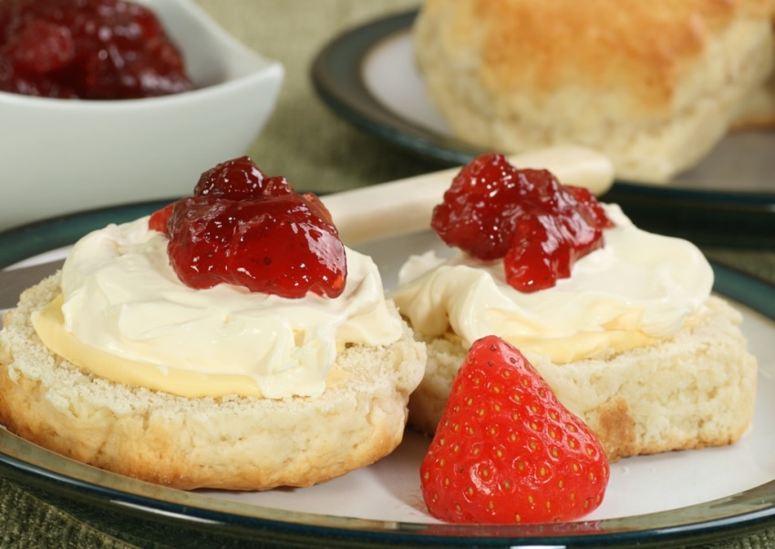
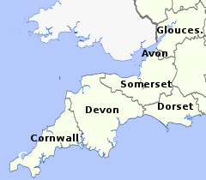
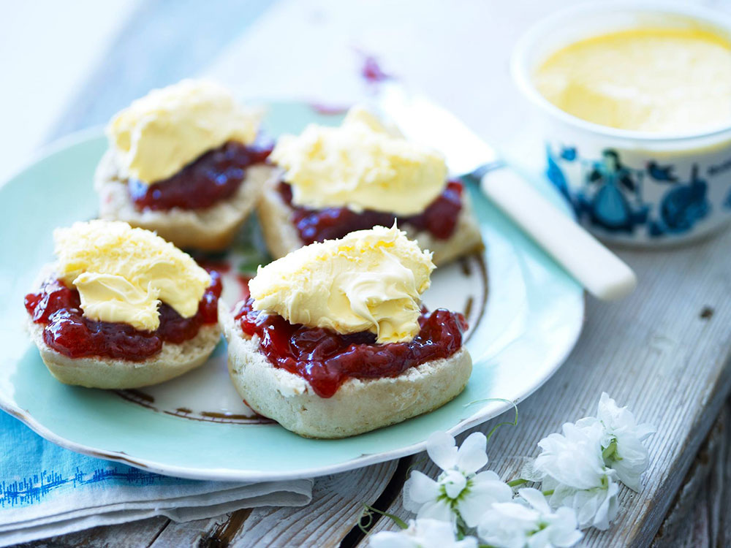
The great cream-tea debate
Devon
Cornwall
What are the biggest food debates in your country?

Slide 3
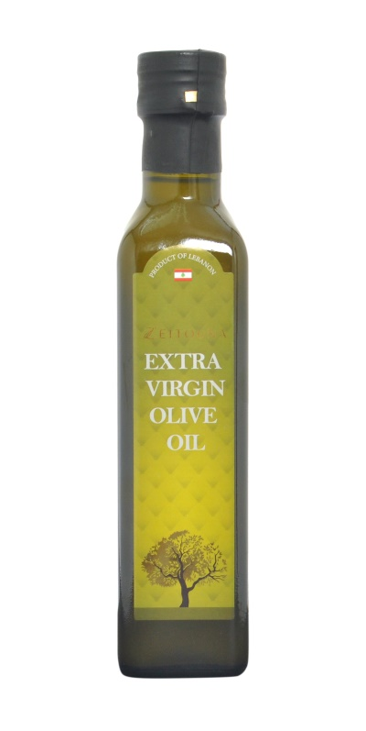
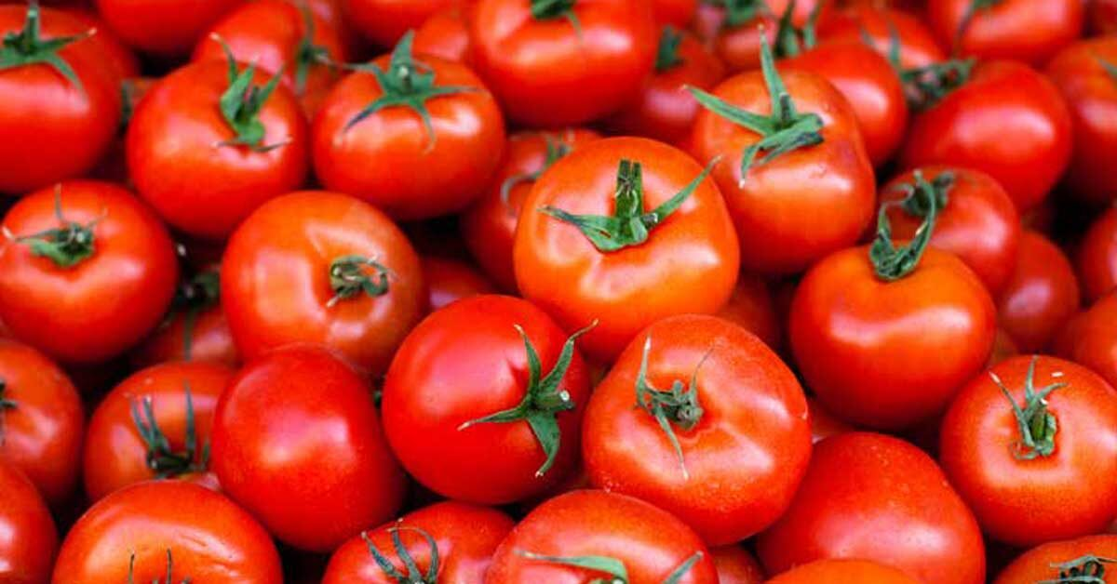
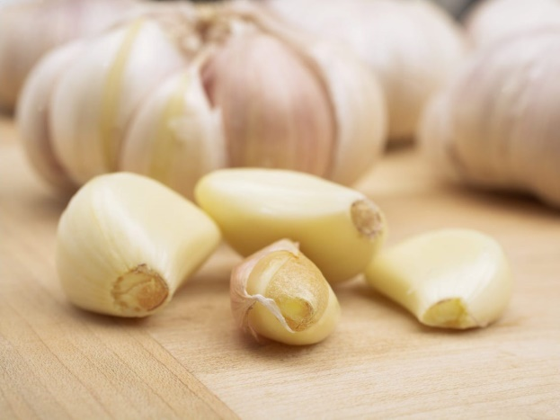
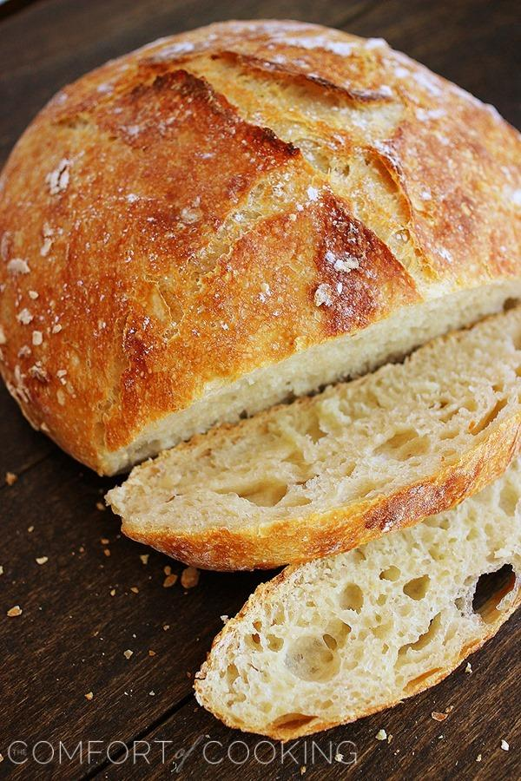
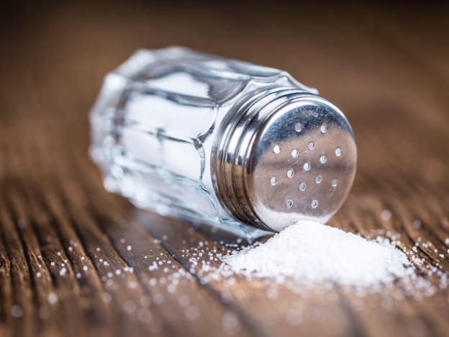
How do you make pan tumaca?

Slide 4


What’s the correct way to dress a salad? What’s the correct order?

Slide 5
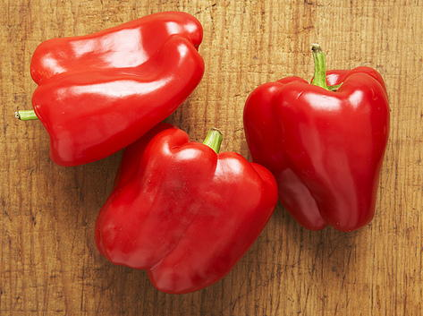

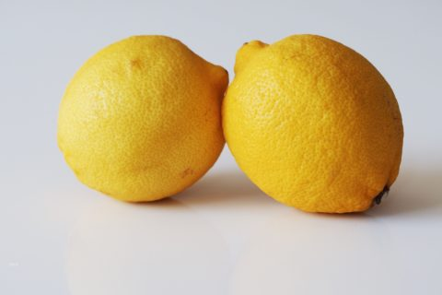
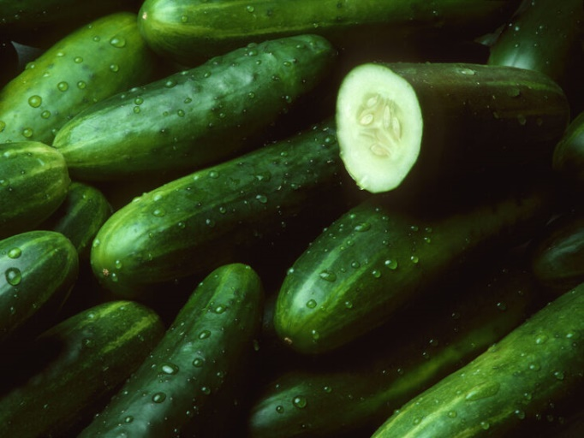
How do you make gazpacho?

Slide 6
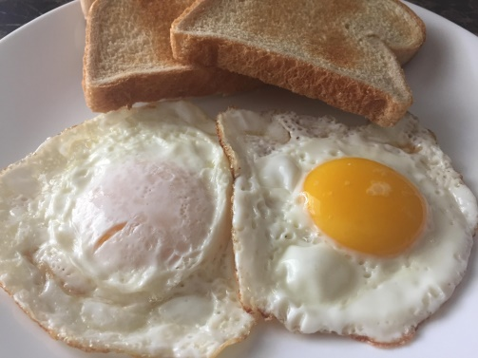
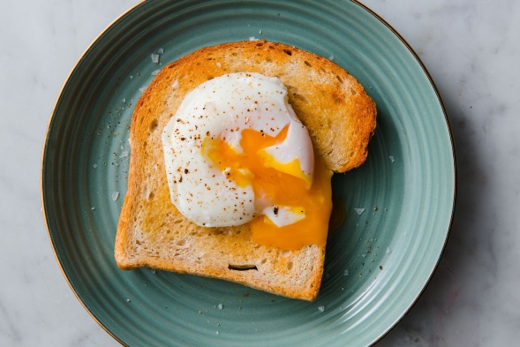
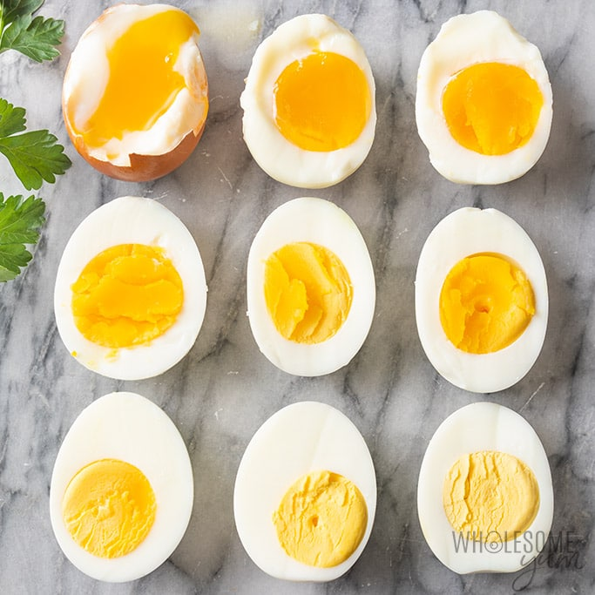
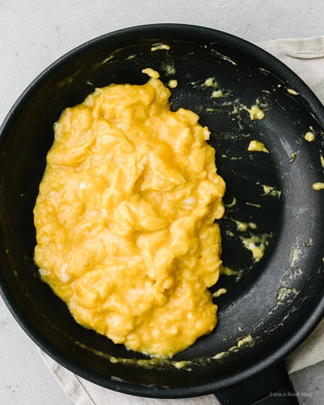
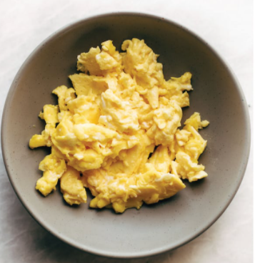
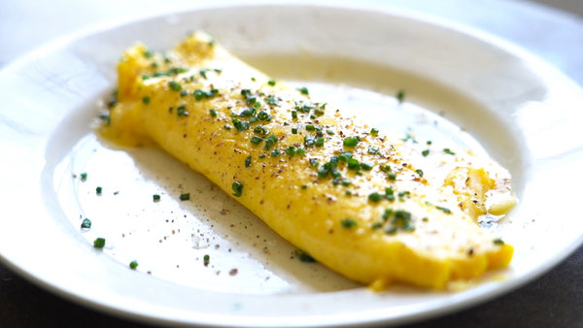
What’s the best way to cook an egg?
Fried, sunny side up/down
poached
Hard/soft boiled
Soft/hard scrambled
Omelette

Slide 7
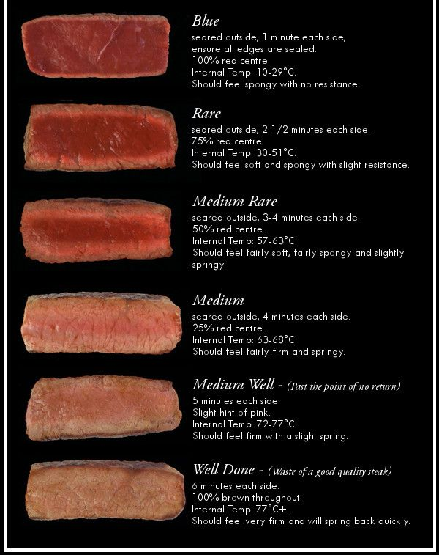
What’s the best way to cook a steak?

Slide 8
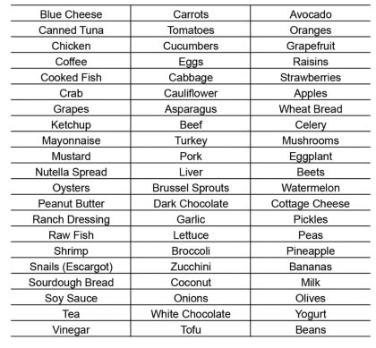
Are you a picky/fussy eater?
1 fussy point for each food you wouldn’t eat.
Who’s the fussiest in the class?

Slide 9

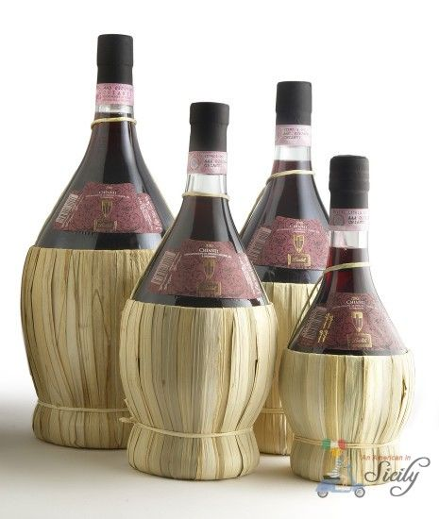

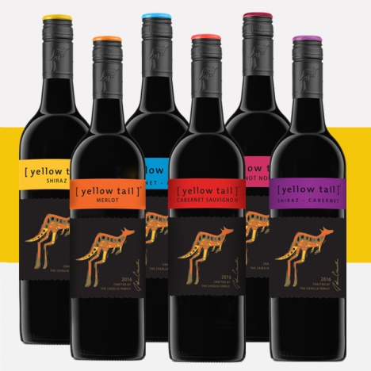
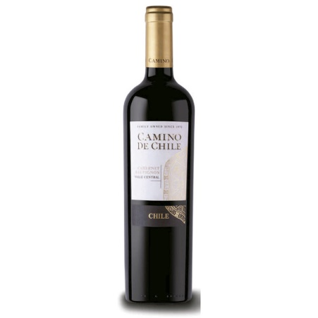
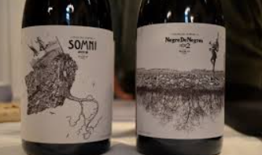
Who makes the best wine?
Spain
France
Italy
Australia
Chile
Catalonia

Slide 10
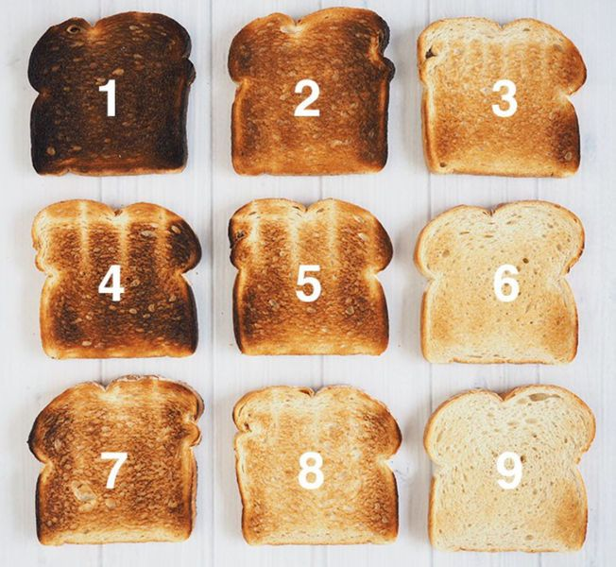
How do you like your toast?

Slide 11
How much do you tip in a restaurant?
0%
5%
10%
20%
What do you think of tipping in general?

Slide 12

What’s the best ice cream flavour?

Slide 13
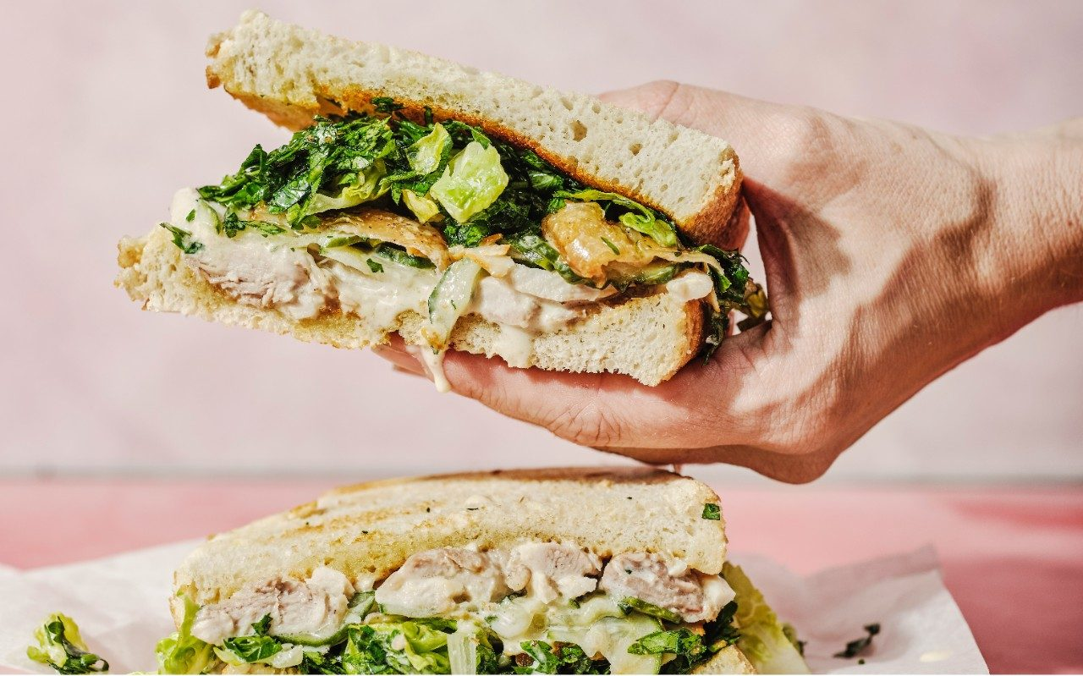
What’s the best sandwich filling?

Slide 14
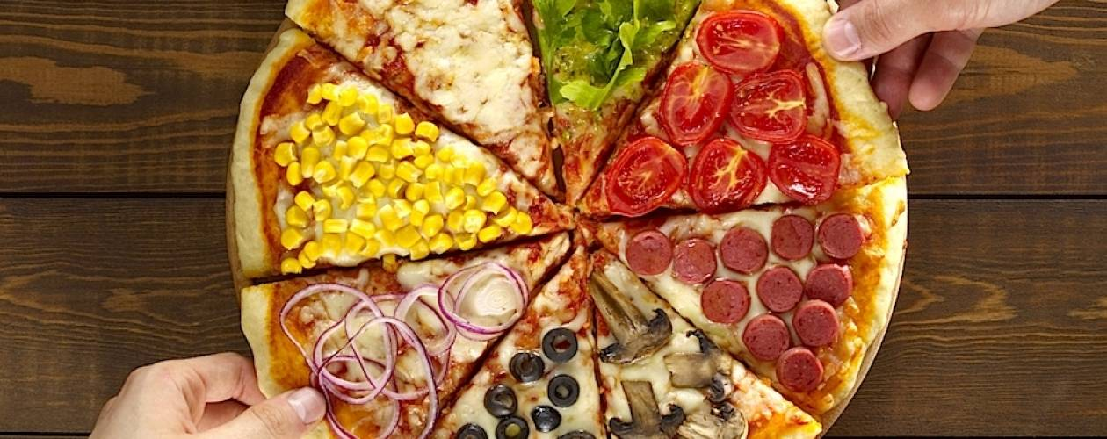
What’s the best pizza topping?
What do you think of pineapple on pizza?

Slide 15

What’s the best dessert you’ve ever had?

Slide 16
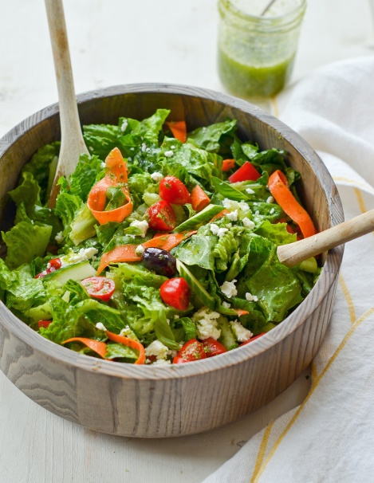
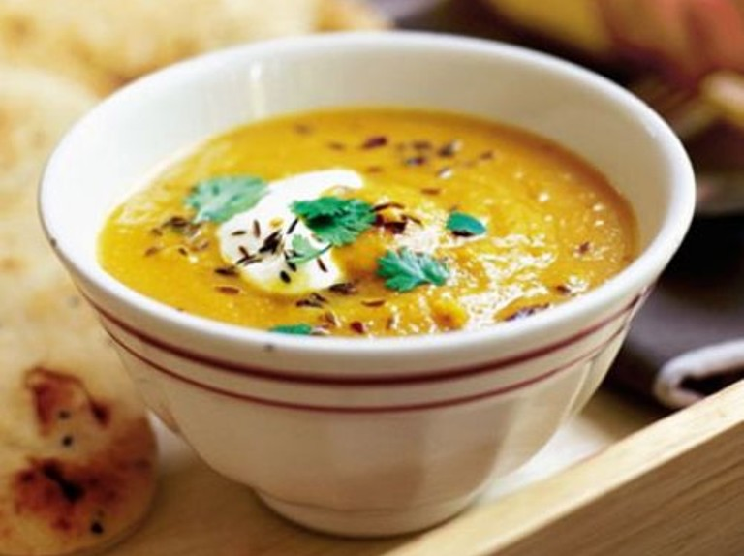
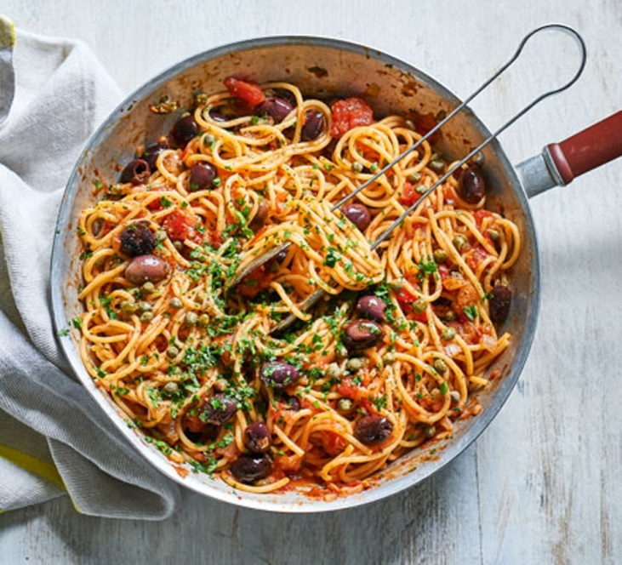
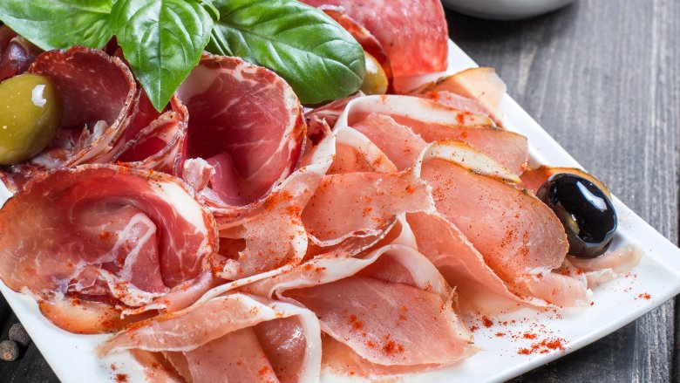
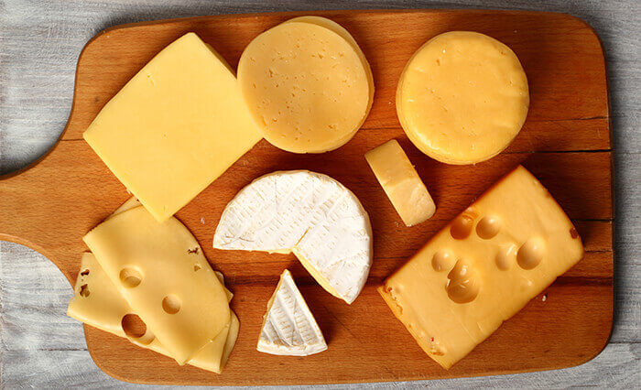
What’s the best type of starter?

Slide 17
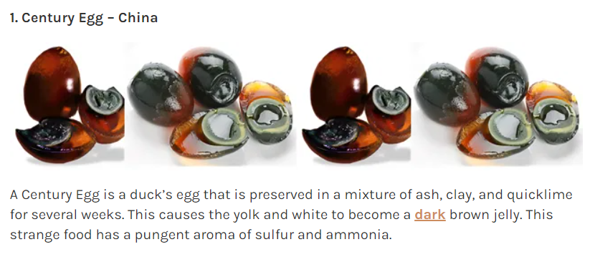
Would you try these weird dishes?
Credit: https://nationalfoods.org/100-bizarre-and-strange-national-dishes-from-around-the-world/

Slide 18
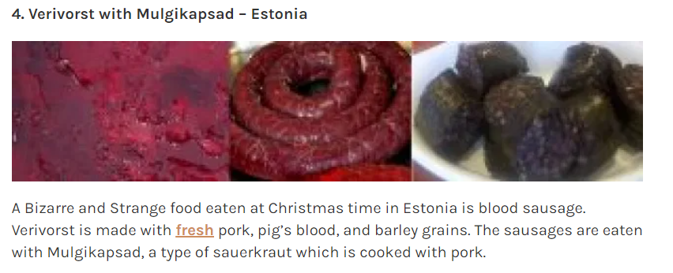

Slide 19
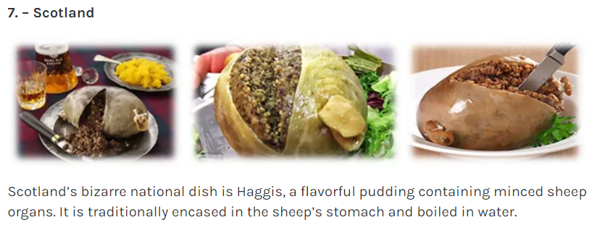

Slide 20
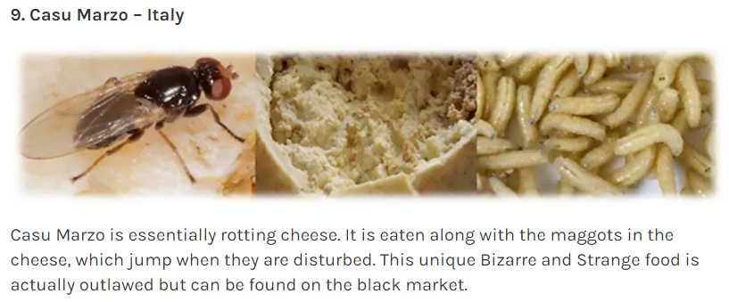

Slide 21
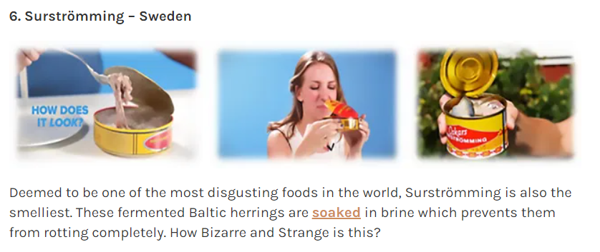

Slide 22
